Slide 1
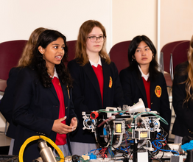
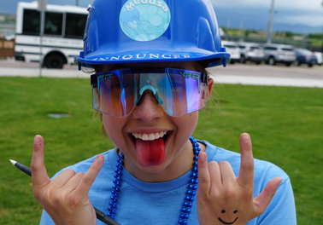
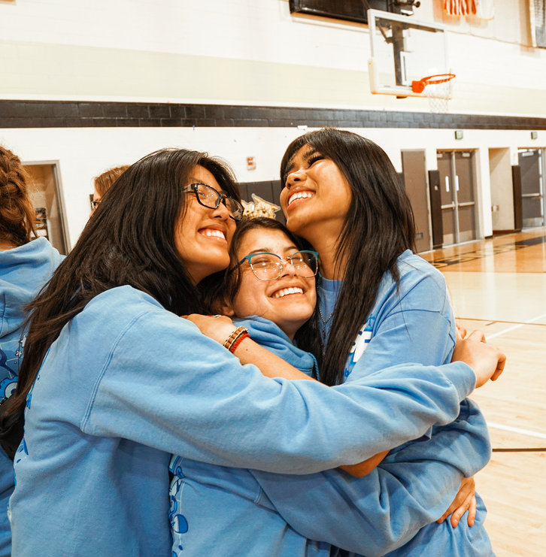
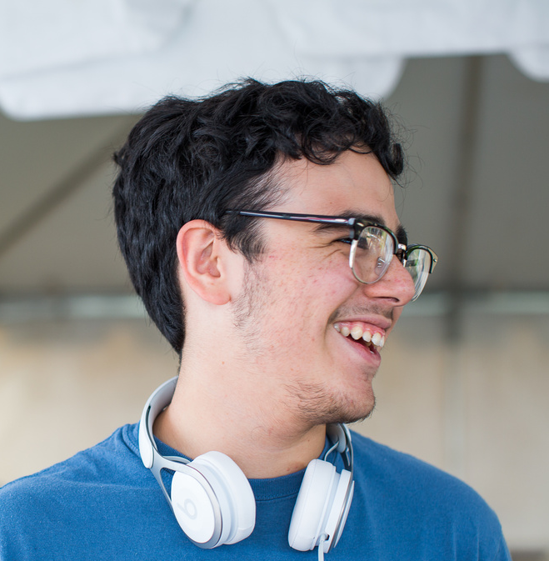
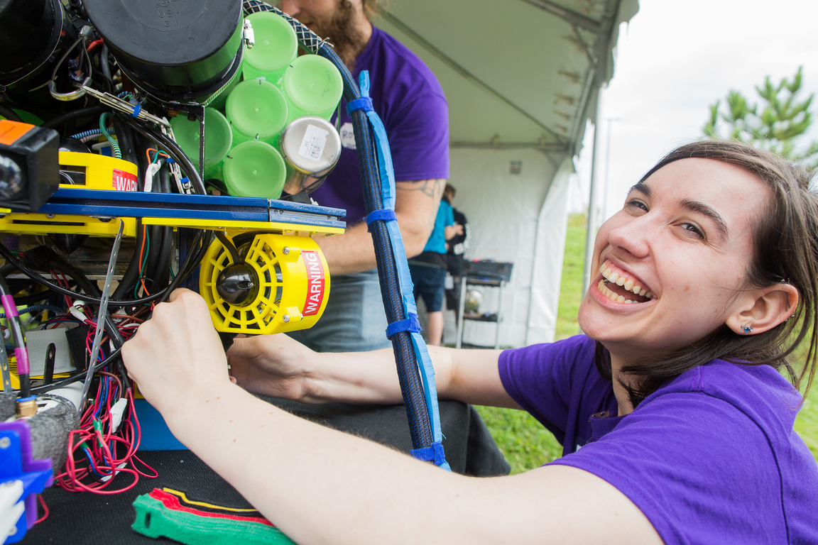
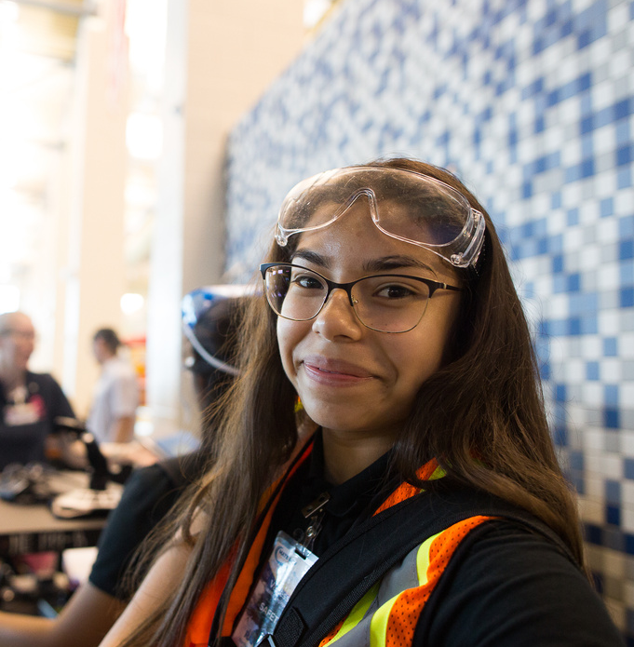
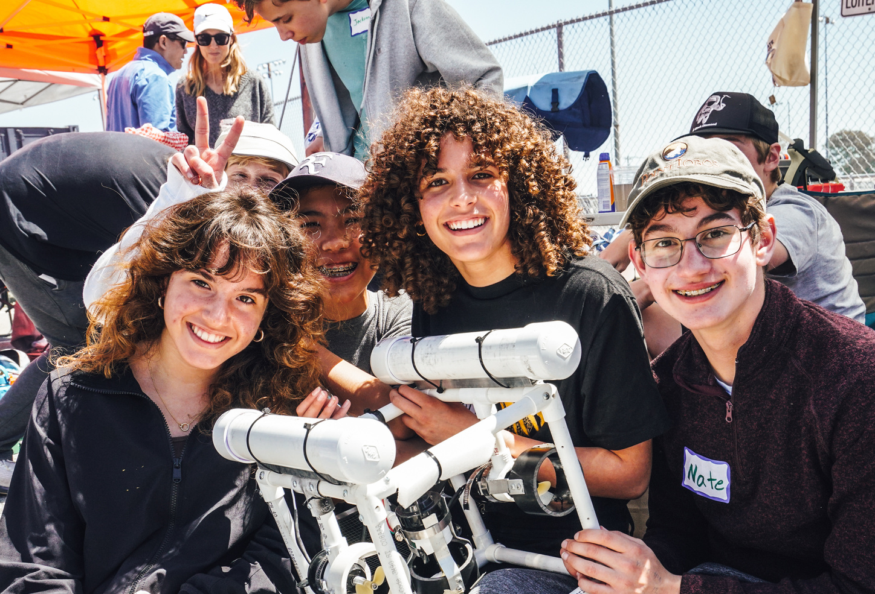
Challenging students to develop skills for the ocean technical workforce
JILL ZANDE
MATE Executive Director | Marine Technology Society (MTS)
Co-PI | National Center for Autonomous Technologies
Chair | MTS Monterey Bay Section
materovcompetition.org

Slide 2
Educational Resources by MATE are licensed under a Creative Commons Attribution-NonCommercial-ShareAlike 4.0 International License.
Based on work at https://materovcompetition.org/rov-kits
Under this license you may download, modify, and share this presentation. Please give credit to MATE for this content. We ask that you do this by retaining this slide and the slide background. You may not use these materials for commercial purposes without written permission from MATE. Please click on the Creative Commons link above for license details.
This material is based upon work supported by the National Science Foundation to the Marine Advanced Technology Education (MATE) Center under Grant Numbers DL/ITEST 1312333 and DUE/ATE 1502046, with contributions from the National Center for Autonomous Technologies (NCAT) NSF/DUE 1902574 subaward to MATE Inspiration for Innovation.
Any opinions, findings, and conclusions or recommendations expressed in this material are those of the authors) and do not necessarily reflect the views of the National Science Foundation.
The Marine Advanced Technology Education (MATE) Center was established with funding by the National Science Foundation via a grant to Monterey Peninsula College in 1997. Founded in 2016, MATE Inspiration for Innovation (MATE Il) was a 501(c)3 non-profit organization inspired and created by the MATE Center to support and sustain educational activities initiated at the Center. On July 1, 2023, MATE Il and its programs, products, and services were integrated into the Marine Technology Society. While the MATE organization has evolved over time, its mission remains the same - to inspire and challenge students to learn and creatively apply science, technology, engineering, and math (STEM) to solving real-world problems in a way that reinforces critical thinking, collaboration, entrepreneurialism, and innovation.
materovcompetition.org

Slide 3
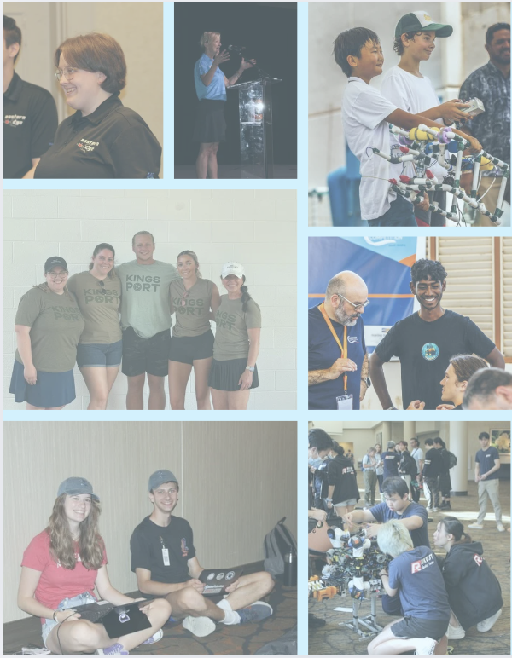
THIS IS
MATE.
Our Mission
MATE's mission is to inspire and challenge students to learn and creatively apply STEM skills to solving real-world problems in a way that strengthens their critical thinking, collaboration, entrepreneurship, and innovation-and prepares them for the Blue Economy workforce.
Our Vision
MATE's vision is a global community of learners, inspired by the ocean, innovating and collaborating to address societal challenges.
materovcompetition.org

Slide 4
Our Competition Philosophy.
The MATE ROV Competition is about student learning.
It is designed to be an educational and inspirational event for students that challenges them to apply the physics, math, electronics, and engineering skills they are learning in the classroom to solving practical problems from the marine workplace.
Mentors (teachers, parents, guardians) are expected to limit their input to educational and inspirational roles and encouraged to focus on benefits to the students from the learning process and not simply “winning” the competition.
materovcompetition.org

Slide 5
PARTNERING WITH THE MTS ROV COMMITTEE TO...
Address the shortage of skilled individuals to support the marine industry
Provide a venue for industry to become involved in education
Increase students' awareness of ocean careers.
Encourage students to develop skills to support marine activities.
Funds - to support student participation
Industry mentors - complement and expand students’ (and educators’) knowledge and expertise
materovcompetition.org

Slide 6
MARINE TECHNOLOGY SOCIETY
The premier convener of the marine technology community, inspiring and advancing innovative ideas for the sustainable use of our ocean.
Join MTS to connect with a global network spanning academia, industry, government, and beyond.
Student Programs & Opportunities
Scholarships
https://www.mtsociety.org/scholarships
Multiple scholarships available for marine studies students
EMERGE Program
https://www.mtsociety.org/emerge-program
Professional mentorship, networking & development, virtual sessions, and attendance at OCEANS 2025
Summer Workshops - Scholarships Available!
https://www.mtsociety.org/mts-summer-workshops
MATE FLOATS! at University of Washington
ROV & Sonar at Northwestern Michigan College
Glider Technology at Rutgers University
materovcompetition.org
Notes:
Pulled updated information from the website to update this slide.

Slide 7
IT STARTED WITH A PILOT REGIONAL IN 2001 AND TO DATE....
Has involved well over 20,000 students in grades 3-16 who work in teams to tackle missions based on the ocean STEM workplace.
Gets students excited about STEM and motivates them to problem-solve, think critically, manage a project, and work together as a team.
Includes one international competition and a network of 45 (and growing!) regional events.
Includes underwater missions and technical reports, engineering presentations, and marketing displays.
Involves 100's of working professionals and organizations.
Was featured in a book, documentary, and Hollywood movie.
Is encouraging students to pursue STEM degrees and jobs in the field.
2025 marks the 23rd Annual MATE ROV Competition World Championship!
materovcompetition.org

Slide 8
COMPETITION REACH (2024)
10
17
COUNTRIES
COUNTRIES
3,065
662
STUDENTS & MENTORS
STUDENTS & MENTORS
30 REGIONAL QUALIFIERS
1 WORLD CHAMPIONSHIP
423
156
VOLUNTEERS
VOLUNTEERS
336
78
TEAMS
TEAMS
materovcompetition.org

Slide 9
TEAM PARTICIPATION (2001–2024)
materovcompetition.org

Slide 10
COMPETITION NETWORK
45 Regional Events
Across the U.S. and Around the World
materovcompetition.org

Slide 11
HISTORY
2010
2022
2011
2024
2009
2023
2021
2012
2008
2020
2007
2013
2019
2005
2014
2006
2018
2004
2015
2003
2017
2016
2002
materovcompetition.org

Slide 12
THANK YOU TO OUR (2024) SPONSORS
FOUNDING SPONSORS
SILVER SPONSORS
DIAMOND SPONSORS
BRONZE SPONSORS
PLATINUM SPONSORS
OTHER SUPPORTERS
GOLD SPONSORS
Martin Klein
materovcompetition.org
Notes:
Pulled updated information from the website to update this slide.

Slide 13
#WATERGAME
materovcompetition.org

Slide 14
COMPETITION STRUCTURE
There’s a class for everyone.
The competition is organized into five classes (levels) that range from beginner to advanced.
This allows students to progress to the next level as they build upon their knowledge and skills and allows us to scale the mission tasks, design specifications, and rules appropriately.
RANGER, PIONEER, and EXPLORER classes all compete at the World Championship.
Competition class level breakdown:
SCOUT: Beginner
NAVIGATOR: Beginner/Intermediate RANGER: Intermediate
PIONEER: Intermediate/Advanced
EXPLORER: Advanced
materovcompetition.org
Notes:
Pulled updated information from the website to update this slide.

Slide 15
COMPETITION STRUCTURE
12 volts, 15 amps
No Camera Required
12 volts, 15 amps
Camera Required
12 volts, 25 amps
Camera Required
12 or 48 volts,
25 or 30 amps
Camera Required
48 volts, 30 amps
Camera Required
Overall:
Platform of your choice (teams are not required to use MATE kits!)
Must follow safety protocol and pass a safety inspection
No limit on building materials, but they must not damage the pool
materovcompetition.org
See the manuals for each competition class for detailed design & building.
Notes:
Pulled updated information from the website to update this slide.

Slide 16
Plus, a
BONUS
MISSION
Shhhh...
It’s a Surprise
materovcompetition.org

Slide 17
HOW MANY TEAMS CAN ENTER?
The number of teams will vary depending on the regional event. More than one team per school/ instructor may be permitted, provided, that there are no common students (i.e., students can only participate on one team).
If the regional cannot host more than one team per school/instructor, teams are encouraged to hold an in-school run-off to determine which team will represent their school/instructor at the competition.
materovcompetition.org
Notes:
Pulled updated information from the website to update this slide.

Slide 18
COMPETITION SAFETY
Pre-competition:
Pneumatics/hydraulics quiz
Safety inspection
Inspection sheet specific to each class posted online
Tutorial posted online walks through each line item on the sheet
Initial pre-competition safety inspection - RANGER & EXPLORER advancing to the World Championship must submit info for review in advance of event
At the event:
Safety inspections
Dedicated safety officers
Process used at the World Championship - teams receive green "passed" safety cards that they must show before entering the water
materovcompetition.org
Notes:
Pulled updated information from the website to update this slide.

Slide 19
NEW SKILLS & OPPORTUNITIES
“Think of yourselves as entrepreneurs”
Operations
Emphasize applying skills in new & innovative ways, working as part of a team, & understanding the breadth of business operations
Challenge students to form companies and structure them with the personnel necessary to design, build, perform, and "sell" their product
CEO
CFO
R&D
Systems Engineering
Gov. Affairs
materovcompetition.org
Marketing
Notes:
Pulled updated information from the website to update this slide.

Slide 20
REQUIRED “PRODUCTS”
Engineering & Communication component includes:
Technical Storytelling
Technical Documentation and Company Spec Sheets*
Oral Presentations
Marketing Displays and Corporate Responsibility
See https://www.materovcompetition.org/archives for examples from previous competitions
materovcompetition.org
Notes:
Pulled updated information from the website to update this slide.

Slide 21
REGIONAL REQUIREMENTS
Teams must prepare and submit at least 2 of the 3 engineering & communication components
Whatever component is not required, regionals are encouraged to offer the winning team(s) a chance to submit it for review and feedback before the World Championship
Teams must prepare and submit a company spec sheet AND SID for the safety inspection
materovcompetition.org
Notes:
Pulled updated information from the website to update this slide.

Slide 22
EMBRACING THE COMPANY APPROACH
Company Names, Logos, Taglines, Marketing Materials...
Examples
Global Ocean Exploring Systems - Providing Surveying, Sampling, and Completion of Underwater Tasks Around the World
Endeavor Enterprises
Triton Technologies
materovcompetition.org
Notes:
Pulled updated information from the website to update this slide.

Slide 23
CREATIVE APPROACHES TO TECHNICAL DOCUMENTATION
Get Creative ROVers!
Previous Example
materovcompetition.org
Notes:
Pulled updated information from the website to update this slide.

Slide 24
ENGINEERING PRESENTATIONS
Presentations are an opportunity to describe the engineering behind the ROV and sell the product to the client (AKA the judges)
Check Out MATE’s Vimeo!
https://vimeo.com/user14545135
materovcompetition.org
Notes:
Pulled updated information from the website to update this slide.

Slide 25
COMPETITION TIMELINE & COSTS
September: Mission Briefing & Preview Task Released
Costs
2025 Registration Fees
ROV & Accessories
Depends on competition class and sophistication of ROV
Budgets are included within the team technical documentation
Travel
November: Specs & Mission Released
December: Registration Opens
April & May: Regional Competitions
June: World Championship
materovcompetition.org
Notes:
Pulled updated information from the website to update this slide.

Slide 26
REGISTRATION FEES
materovcompetition.org
Notes:
Pulled updated information from the website to update this slide.

Slide 27
COMPETITION RESOURCES
MATE ROV Competition website https://www.materovcompetition.org
Eligibility information, links to regional sites
Teams only area, FAQs board
Archive of technical documentation
Workshops
Regional
@ МАТЕ
Access to mentors
materovcompetition.org
Notes:
Pulled updated information from the website to update this slide.

Slide 28
COMPETITION RESOURCES
MATE ROV Academy
https://materovcompetition.org/professional-development
Free learning workshops and resources
Workforce reports
Knowledge and skill guidelines
SeaMATE Store
https://seamate.org
One stop shop for MATE!
ROV kits, tool kits, accessories, add-ons, powerpoles, books and guidelines, crimpers, and more!
materovcompetition.org
Notes:
Pulled updated information from the website to update this slide.

Slide 29
RETURN ON INVESTMENT
With MATE, students have...
Used the MATE competition as the focus of college entrance essays
Gone on to work at research facilities like WHOl and MBARI
Gone on to pursue engineering or technical degrees
Started their own companies (OpenROV and Mission Robotics)
Been awarded scholarships or internships as a result of their participation in the ROV competition
Been hired by Oceaneering International, Schilling Robotics, General Motors, Virgin Voyages, NASA, Disney, and more!
View our Annual Impact Report for more information.
materovcompetition.org

Slide 30
2025 WORLD CHAMPIONSHIP
UN Decade of the Ocean, MATE Year of the Great Lakes: Monitoring and Mitigating the Impacts of Climate Change on Our Water World
June 19-21 (Team Inspections June 17-18)
Thunder Bay National Marine Sanctuary
Alpena, Michigan, United States
TASK #1: Shipwrecks, Spotter Buoys, and Flying Fish: Documenting the Impact of Climate Change and Invasive Species on the Great Lakes
TASK #2: Marine Renewable Energy: Producing Power from Our Planet While Monitoring Environmental Impact
TASK #3: MATE Floats!
materovcompetition.org
Notes:
Pulled updated information from the website to update this slide.

Slide 31
Questions?
JILL ZANDE
MATE Executive Director
jill.zande@mtsociety.org
(831) 646-3082
www.materovcompetition.org
www.mtsociety.org

