Slide 1

NAVIGATOR & SCOUT Class Safety Inspection Tutorial
This tutorial goes through the safety practices required by the MATE ROV Competition. It covers:
Initial Safety Inspection (if required)
Onsite Safety Inspection
Examples and photographs of what will and will not pass safety inspection

Slide 2
SCOUT & NAVIGATOR Class Safety Inspection Sheet Tutorial
INITIAL SAFETY INSPECTION
Most regionals DO NOT require SCOUT and NAVIGATOR teams to turn in safety documentation early for an Initial Safety Inspection.
Your regional coordinator will let you know if any documentation is due early. Contact your regional coordinator or check your regional information page for information on any documentation due prior to competition day.
Most regional require the following documentation on competition day:
SID (ROV electrical)
SID (non-ROV device – if used)
SID (fluid power – if used)
These documents will be reviewed during your onsite safety inspection.
A Non-ROV device description, if a float is built, is required for mission task 4, MATE Floats! and may be required for your safety inspection.

Slide 3
SCOUT & NAVIGATOR Class Safety Inspection Sheet Tutorial
DOCUMENTATION REQUIRED
DOC-001: Companies must provide a system interconnection diagram (SID) of their vehicle control system. An SID is an electrical diagram of their wiring, including their control box, motors, and any other electrical systems on their vehicle. The SID should separate and show what systems are on the surface and what systems are on the vehicle.
The SID is the starting point for SCOUT & NAVIGATOR Safety.
Companies should be aware of safety and every team is required to submit a SID. If not required early by the regional, a SID must be present for the on-site safety inspection.
DOC-002: Any electrical diagram should use ANSI, NEMA, or IEC symbols. They should be neatly hand drawn or created using a CAD software program.
AN EXAMPLE OF A SID IS SHOWN IN THE COMPETITION MANUAL.
DOC-003: Companies using fluid power must submit a fluid interconnection diagram (Fluid SID) of their system. Companies using syringe hydraulics only need a simple diagram and could include it on their electrical SID. NAVIGATOR companies using powered pumps or compressors MUST include a full fluid SID.

Slide 4
SCOUT & NAVIGATOR Class Safety Inspection Sheet Tutorial
Onsite Safety Inspection
Safety is the competition’s primary concern and guiding principle. Any system that is considered unsafe by competition officials will not be allowed to compete.
If a concern is found during the first safety inspection, companies are permitted to attempt to correct it and have their ROV re-inspected. However, the competition schedule will NOT change to allow companies more time.
Companies are allowed to have their vehicle re-inspected twice. If a company fails to pass its third and final safety inspection, it is disqualified from the underwater competition portion of the event. There are NO APPEALS once your ROV has been disqualified.

Slide 5
SCOUT & NAVIGATOR Class Safety Inspection Sheet Tutorial
Onsite Safety Inspection
Examples of safety violations from previous ROV competitions include:
The ROV does not use Anderson Powerpole connectors to attach to main power.
No SID was provided at the safety check.
The SID did not show a main fuse.
The ROV used pneumatics, but the technical documentation did not include a pneumatics diagram (fluid SID).
Sharp items, or potentially sharp items, (fishing hooks, glass bottles) were included on the vehicle.
The vehicle motors were not waterproofed.
Propellers were not protected inside the framework or not shrouded.
Note for 2026 NAVIGATOR Class teams!!! Propellers MUST be shrouded to IP-20 standards. This means an ½-inch (1.252 cm) wooden dowel cannot touch any propeller.
Note for 2026 teams!!! Any gear assemblies must be shrouded to IP-20 standards.
Camera did not operate off the 12-volt MATE power supply.

Slide 6
SCOUT & NAVIGATOR Class Safety Inspection Protocol
Onsite Safety Inspection
Competition staff will conduct a safety inspection of the vehicle using the safety inspection rubric.
  The rubric / scoresheet is posted. If you want to know exactly what will be evaluated during your onsite safety inspection, look at this score sheet.
If the safety inspector(s) identify a safety violation, companies will have the opportunity to address it. The pool practice or product demonstration run schedule will NOT change to allow companies more time.
If during the second safety review the
a. violation has not been properly addressed or
b. another violation is revealed
companies will have ONE additional opportunity to address the issue.

Slide 7
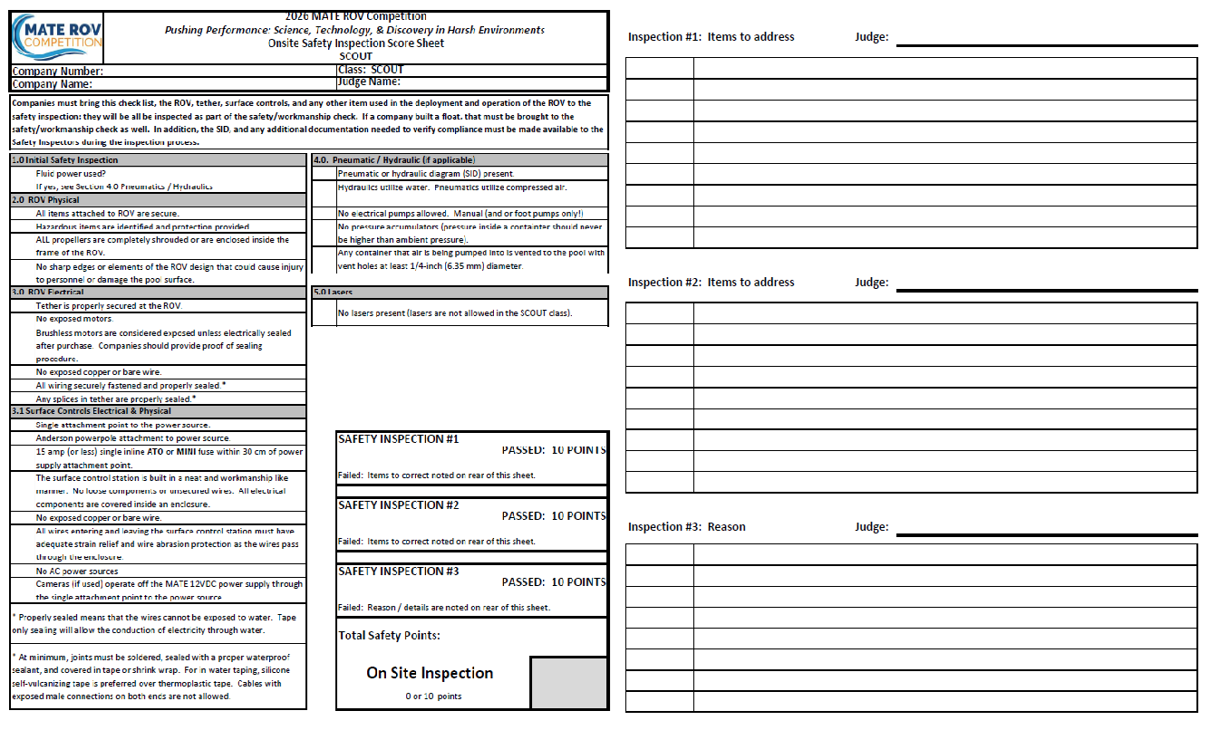
SCOUT SAFETY INSPECTION SHEET
http://materovcompetition.org/scoring

Slide 8
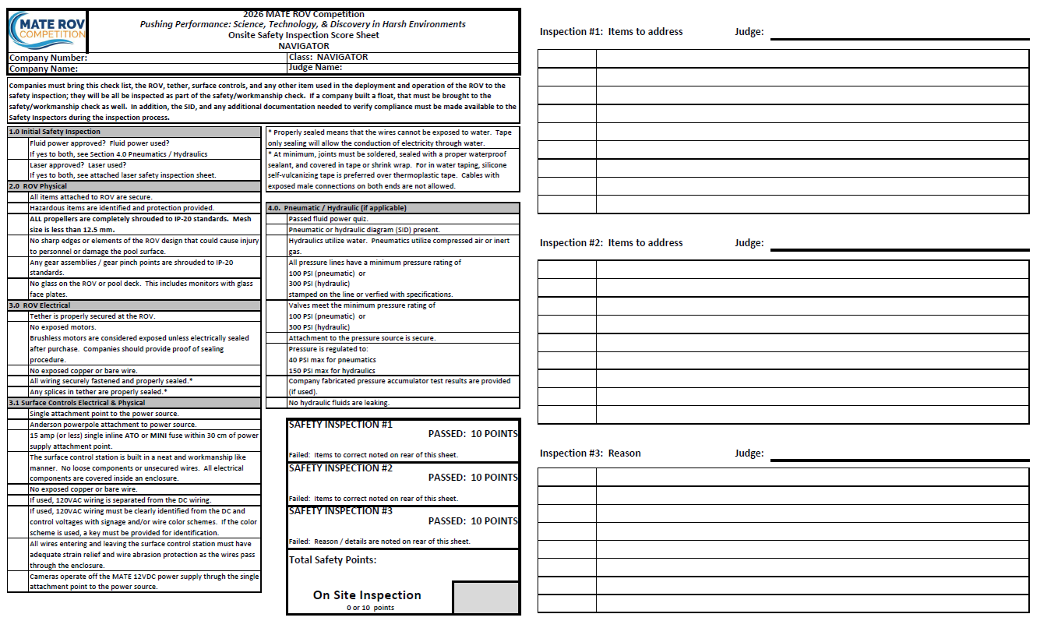
NAVIGATOR SAFETY INSPECTION SHEET
http://materovcompetition.org/scoring

Slide 9
SCOUT & NAVIGATOR Class Safety Inspection Protocol
2026 MATE Floats!
Documentation
If you plan to operate a float you will need to bring both a SID of your float and a non-ROV device description document to the onsite safety inspection. Hint: A simple float is probably a 1-motor ROV. SID should include the power source, fuse, tether, motor(s).
New for 2026!!! ALL TEAMS will also need to bring a non-ROV device description document with them. This details the power source and movement mechanisms for the float.
    The non-ROV device description document should be presented to safety inspectors. It MUST also be brought to the mission station and presented to the mission station judges to receive points for Task 4.
  The non-ROV device document should let the station judges know what type of float you designed – which category on the score sheet it fits into (buoyancy engine / other mechanism), independent (NAV only) or tethered, autonomous or manually controlled. The document should also explain why/how your float fits into that category.

Slide 10
SCOUT & NAVIGATOR Class Safety Inspection Protocol
Examples and photos of items that will (and will not) pass a safety inspection.
The following section has examples (with photos) of what will or will not pass safety inspection.

Slide 11
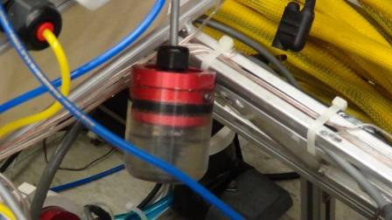
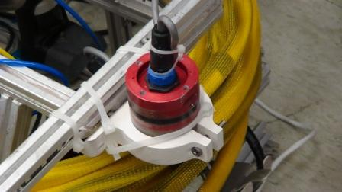
SCOUT & NAVIGATOR Class Safety Inspection Protocol
2.0 Physical
All items attached to ROV are secure and will not fall off.
Examples:
loose camera securely attached camera
Note for NAVIGATOR class: Large monitors not secured to the control station will be considered a loose item. Any monitor / video screen should be secured to the control station or stabilized on the table.

Slide 12
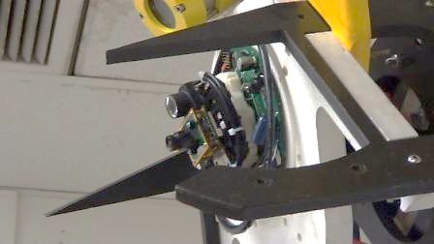
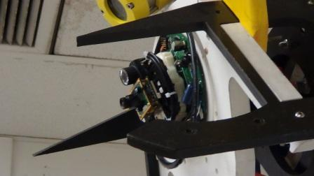
SCOUT & NAVIGATOR Class Safety Inspection Protocol
2.0 Physical
No sharp edges or elements of ROV design that could cause injury to personnel or damage to pool surface.
Examples:
The points on the front of this ROV may look cool, but the inspector failed the company during safety inspection for putting something that could be a danger to the divers.
NOTE: Monitors with glass fronts could create sharp edges if they become broken! Monitors with glass fronts will not pass safety inspection.
12
Notes:
12

Slide 13
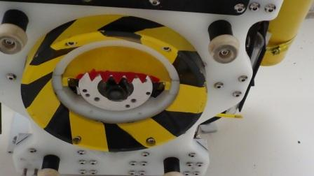
SCOUT & NAVIGATOR Class Safety Inspection Protocol
2.0 Physical
Hazardous items are identified and protection provided.
Examples:
Sharp edges on the scoop are painted red; yellow and black safety warning colors are used elsewhere. The company successfully passed their safety inspection because potentially hazardous items that are needed to complete a task are identified and protected.
13
Notes:
13

Slide 14
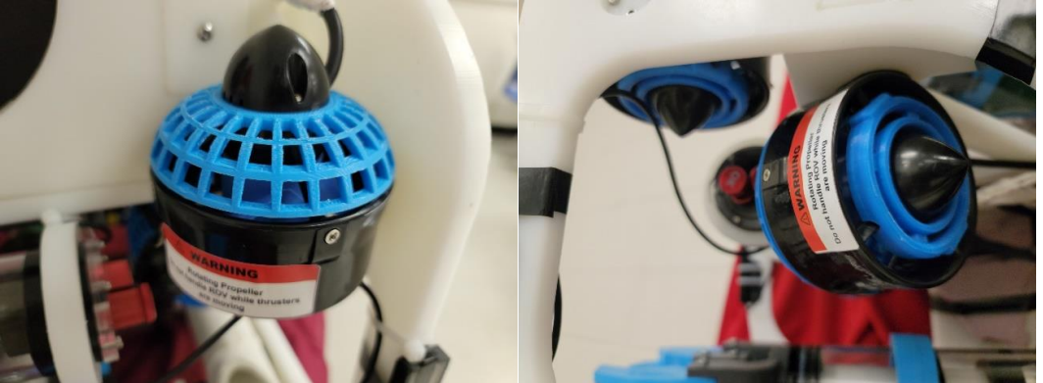
RANGER, PIONEER & EXPLORER Class Safety Inspection Sheet Tutorial
2.0 Physical
NAVIGATOR: Propellers must be shrouded to IP-20 standards even if they are enclosed inside the frame of the ROV
Eastern Edge Robotics shrouds. Photo credit: Stephen Fudge
Propellers are properly shrouded to IP-20 standards on both sides of the propeller. These shrouds were 3D printed. A ½-inch wooden dowel cannot touch the propeller from any angle.
14
Notes:
14

Slide 15
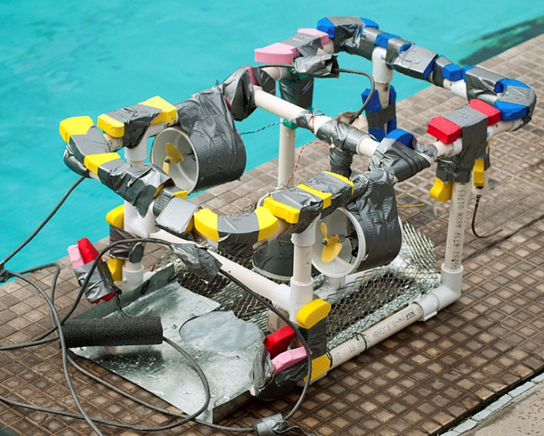
SCOUT & NAVIGATOR Class Safety Inspection Protocol
2.0 Physical
SCOUT!
ALL Propellers must be shrouded or completely enclosed inside the frame of the ROV
If your ROV bumps up
against the wall of the pool,
turning propellers should
not impact the side of the
pool or other objects.
15
Notes:
15

Slide 16
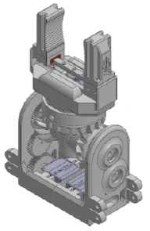
RANGER, PIONEER & EXPLORER Class Safety Inspection Sheet Tutorial
2.0 Physical
Any gear mechanism must be shrouded to IP-20 standards
New for 2026, Any gear assemblies must be fully shrouded. Turning gears create pinch points that can cause injury. Geared systems are allowed, but the gears should be shrouded and protected to IP-20 standards (solid particulate protection level 2). This IP code equates to a mesh size <12.5 mm, but companies may use a solid covering as well. If a finger can touch the gear assembly, then it is not properly shrouded.
Image from AASTMT Triton Technical Documentation.
16
Notes:
16

Slide 17
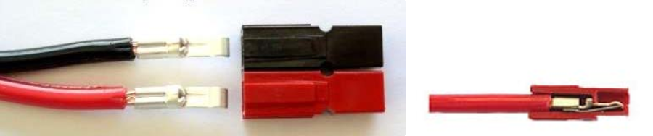
SCOUT & NAVIGATOR Class Safety Inspection Protocol
3.0 Electrical
Single attachment point to power source.
Anderson powerpole connectors are required to connect to the MATE power source.
A single inline fuse (not shown) must be within 30cm of attachment point (power connectors). Fuses in each line are acceptable.
NAVIGATOR and SCOUT class utilize the RED & BLACK powerpole connectors. Looking at the end of the connectors, you will see a small A on the end of each. With the tip of the A pointing up, black should be on the left and red on the right
17
Notes:
17

Slide 18
SCOUT & NAVIGATOR Class Safety Inspection Protocol
3.0 Electrical
Problems with the Anderson powerpoles have developed when teams do NOT use the proper crimper for these connectors.
Standard Electricians Crimpers will NOT work!
The crimp must be a roll crimp not a “squish” crimp.
18
Notes:
18

Slide 19
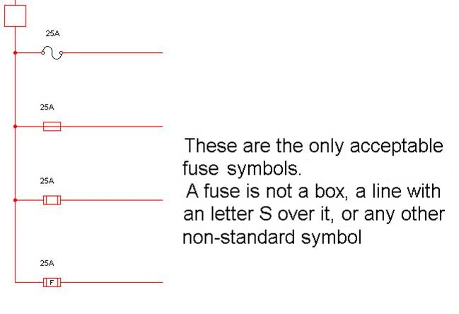
SCOUT & NAVIGATOR Class Safety Inspection Sheet Tutorial
3.0 Electrical
System Interconnection Diagram (SID)
System Interconnection Diagram (SID) A SID is a system-level, connection diagram that includes electrical and, if applicable, fluid power wiring information. Board-level and component-level schematics should not be included; however, these may be brought to the engineering evaluation for reference purposes. The intent is to provide the competition judges with a one-line diagram showing how the various systems are interconnected without the detail of each and every wire.
See the Competition Manual or the next two slides for examples of a SID. However, you must create your own SID for your vehicle. Do not directly copy the SID from a MATE resource, even if it is a proper SID for your vehicle.
19
Notes:
19

Slide 20
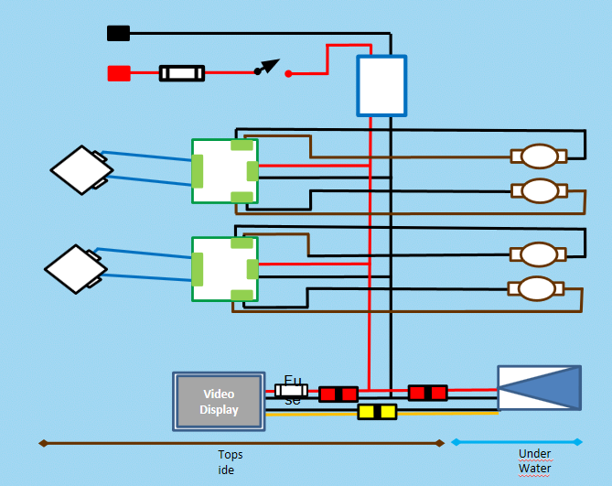
Example SID 1

Slide 21
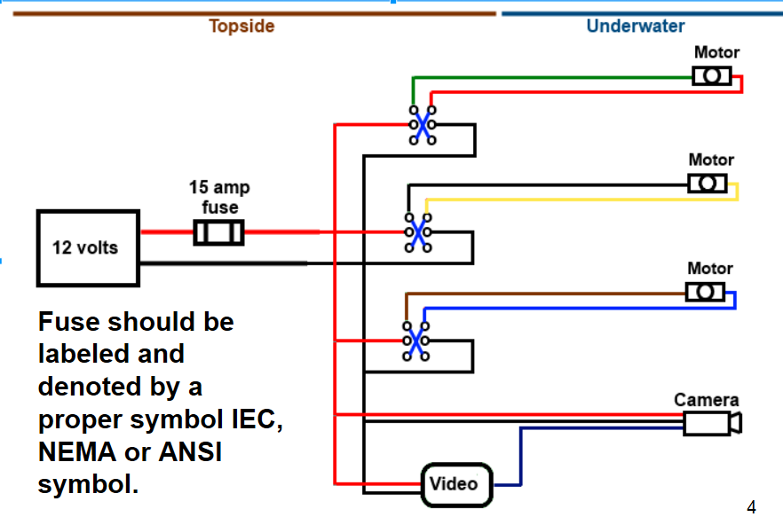
Example SID 2

Slide 22
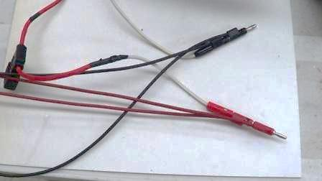
SCOUT & NAVIGATOR Class Safety Inspection Sheet Tutorial
3.0 Electrical
Single inline fuse within 30cm of attachment point.
Examples:
This is an example of multiple attachments ahead of the fuse that WILL NOT PASS.
In addition, MATE no longer uses banana plugs for power attachment.
22
Notes:
22

Slide 23
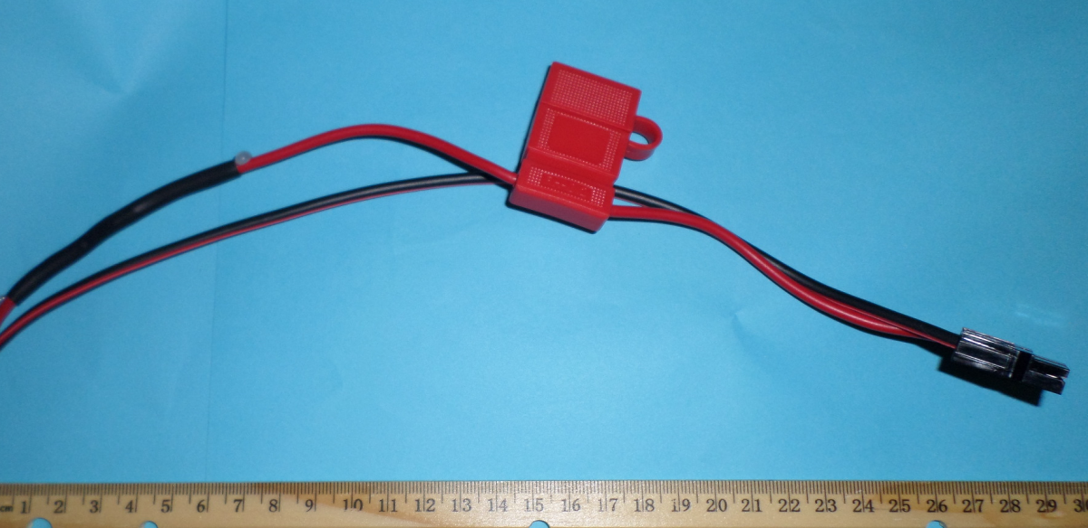
SCOUT & NAVIGATOR Class Safety Inspection Sheet Tutorial
3.0 Electrical
Single inline fuse within 30cm of attachment point.
Safety inspectors want to see the proper Anderson connection to the MATE power supply (where you plug into the power supply) and a fuse within 30 cm.
Nothing should be in between this connection to power and the fuse!
23
Notes:
23

Slide 24
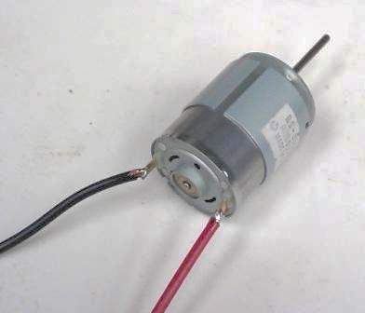
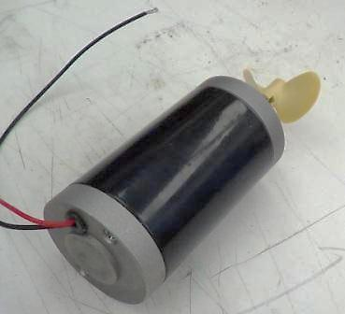
SCOUT & NAVIGATOR Class Safety Inspection Sheet Tutorial
3.0 Electrical
No exposed copper or bare wire. No exposed motors.
Examples:
These WILL NOT PASS. The motor on the left is both exposed and has bare wire.
The motor on the right is exposed and not sealed.
24
Notes:
24

Slide 25
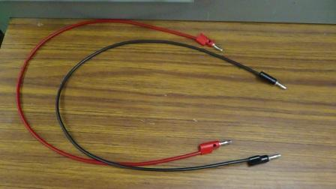
SCOUT & NAVIGATOR Class Safety Inspection Sheet Tutorial
3.0 Electrical
No exposed copper or bare wire.
Examples:
This WILL NOT PASS. Using banana plugs at both ends of the wire to route power from one section to another violates MATE’s safety rules. It is possible for the hot end of the wire to become unplugged and create a safety hazard.
25
Notes:
25

Slide 26
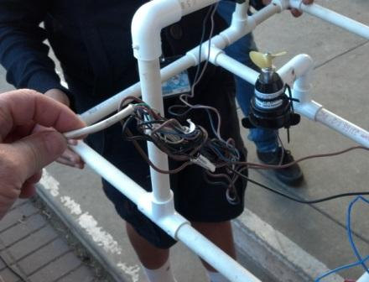
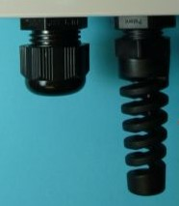
SCOUT & NAVIGATOR Class Safety Inspection Sheet Tutorial
3.0 Electrical
Tether is properly secured at surface control point and at ROV.
Example:
The wires on the ROV are loose or could get caught in a propeller when moving around the pool. Use tape, cable ties, or other methods to secure the wires away from any moving or potentially dangers parts.
Wires entering into the control box should also be secured. If you accidentally walk the controller away from the ROV, you want any strain to be contained. You do not want to pull wires inside the control box.
26
Notes:
26

Slide 27
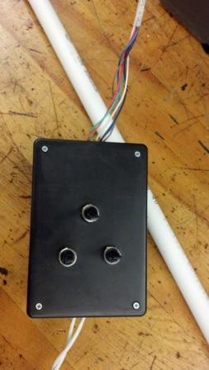
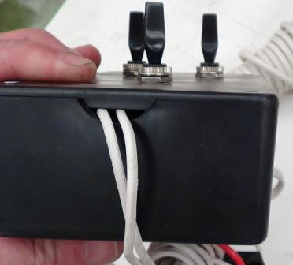
SCOUT & NAVIGATOR Class Safety Inspection Sheet Tutorial
3.0 Electrical
Surface controls: All wiring and devices properly secured.
Examples:
The two pictures below are examples of loose wiring. There is no strain relief and the wires can easily pull loose from their connections. Hot melt glue and tape are not acceptable strain relief items.
27
Notes:
27

Slide 28
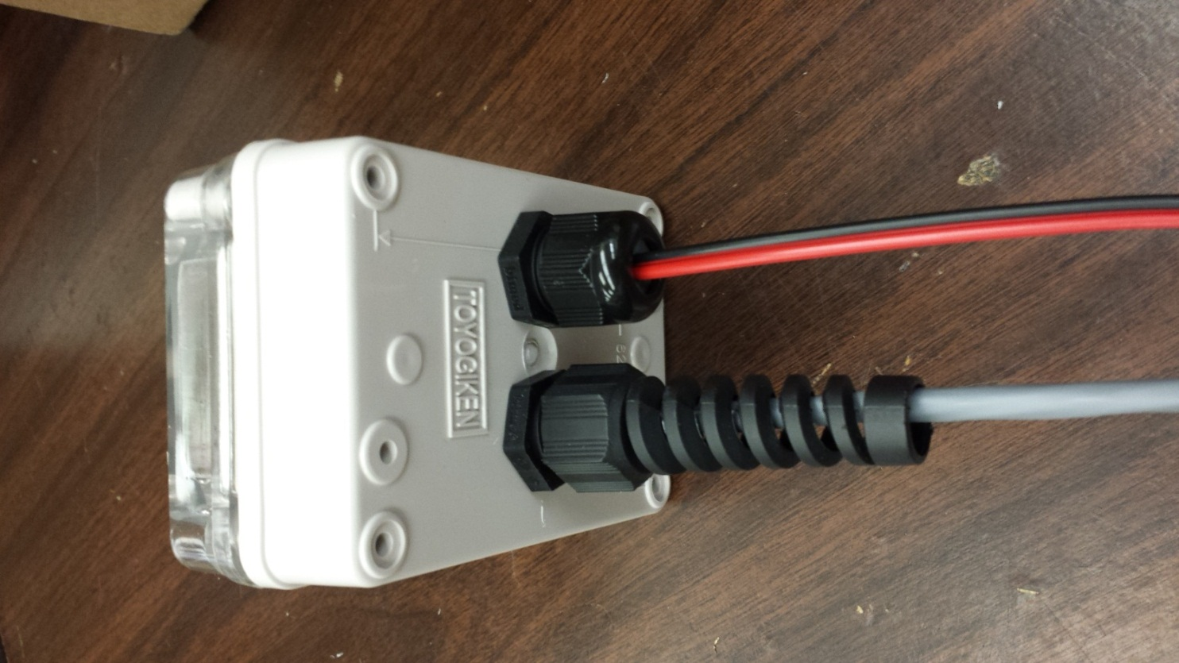
SCOUT & NAVIGATOR Class Safety Inspection Sheet Tutorial
3.0 Electrical
Surface controls: All wiring and devices properly secured.
Example: both the red/black power wires and the tether wires going into the control box are properly secured by tight strain relief.
28
Notes:
28

Slide 29
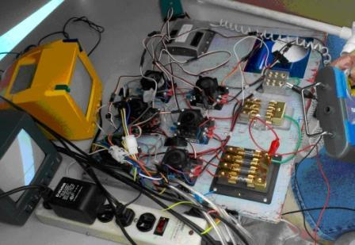
SCOUT & NAVIGATOR Class Safety Inspection Sheet Tutorial
3.0 Electrical
Surface controls: All control elements are mounted with wiring inside an enclosure.
There are multiple FAILS in the picture below!
Exposed wiring
Multiple fuses instead of single point fuse for power.
Loose wires.
Alligator clips used for connections.
No strain relief provided for wires coming from power or going to ROV.
See the MATE Expected Work Practices for more on wire discipline.
29
Notes:
29

Slide 30
SCOUT & NAVIGATOR Class Safety Inspection Sheet Tutorial
Fluid Power
SCOUT class or NAVIGATOR class using manual pumps only
4.0 Pneumatic / Hydraulic Checklist
Is a pneumatic or hydraulic diagrams (SID) present?
Is the team using a Hand or Foot pump only?
Is the fluid air or water?
Are teams pressurizing a container (not allowed for SCOUT)
Does any container that air is being pumped into is vented to the pool with vent holes at least ¼” (6.35mm) in diameter?
30
Notes:
30

Slide 31
SCOUT & NAVIGATOR Class Safety Inspection Sheet Tutorial
Fluid Power
NAVIGATOR class (only) if using pressurized fluid power.
4.0 Pneumatic / Hydraulic Checklist
Did you PASS the Fluid Power Quiz?
Do you have your pneumatic or hydraulic SID(s) present?
Are pneumatic and/or hydraulic component specifications provided? Are you using pressure rated lines and fittings?
Is your attachment to pressure source is secure?
Is your pressure regulated to 40psi max for pneumatics and 150 psi max for hydraulics? COMPANIES MUST PROVIDE THE REGULATOR.
If a company fabricated pressure accumulator is used, are pressure test results provided?
Are hydraulic fluids leaking?
Do your pneumatics utilize compressed air or inert gas?
MATE will not provide compressors (see regional information) but see Compressed Air Guidelines for what components you should have in your system.
31
Notes:
31

Slide 32
SCOUT & NAVIGATOR Class Safety Inspection Sheet Tutorial
5.0 Laser Checklist (NAVIGATOR only)
Did the team send the laser specs to the competition technical manager two weeks prior to the regional?
Does your SID show the laser driver (laser power source)?
Does your laser have an on/off switch on the surface controller?
Is the laser powered through the MATE surface power supply?
Are batteries used to power the laser? (this is not allowed)
Are your lasers the proper type? Visible Laser in 630-680 nm (red) or near 532 nm (green) Class I, Class II, or Class IIIa Category; Red Laser: 5mW or less. Green Laser: 1 mW or less. Be sure and bring your laser specs to the safety inspection.
Is the laser voltage at or below laser rated voltage & current?
Was a specification sheet showing laser and laser glasses sent to, and approved by, MATE Competition technical manager prior to event?
Does your ROV have a Laser shield or beam stop attachment within 30 cm of laser when out of water?
Do the team members have laser safety glasses, regardless of the laser output power?
32
Notes:
32

Slide 33
SCOUT & NAVIGATOR Class Safety Inspection Sheet Tutorial
SAFETY FIRST!
Our goal is not to fail teams and keep them from competing, but rather to run a fair and SAFE competition for all. We work with industry to align the MATE safety specifications with industry standards. We want to familiarize our competitors with the safety specifications they may see one day in the workforce.
If you have a question or concern, contact that MATE ROV Competition Technical Manager on the MATE Q&A Forum Board. In this case it is better to ask for permission, not forgiveness. Remember, it is better to be SAFE than sorry!

